Slide 1
Chapter 18
How to build a GUI program

Slide 2
Objectives
Applied
Develop a GUI program that has a user interface that consists of frames, buttons, labels, and text entry fields in a grid format.
Knowledge
Describe the need for the mainloop() method of a tkinter root window in terms of the event processing loop.
Describe the way an event handler works with a GUI component like a button.
Describe how the grid() method is used to lay out the components in a frame.
Describe the reason for creating a subclass of the ttk.Frame class when you’re building a GUI.
Describe how to use a message box to display a message to the user of a program

Slide 3
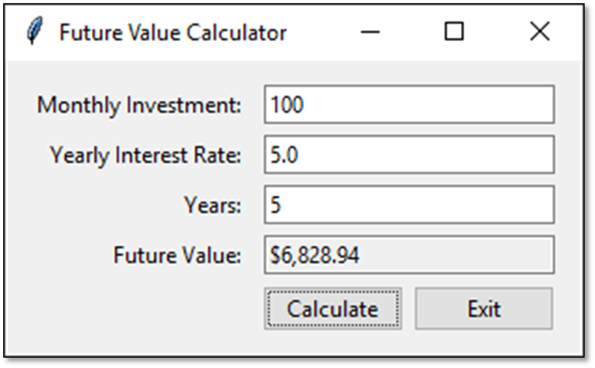
A window with ten components

Slide 4
The constructor of the root window
Tk()
The methods of the root window
title(title)
geometry(str)
mainloop()

Slide 5
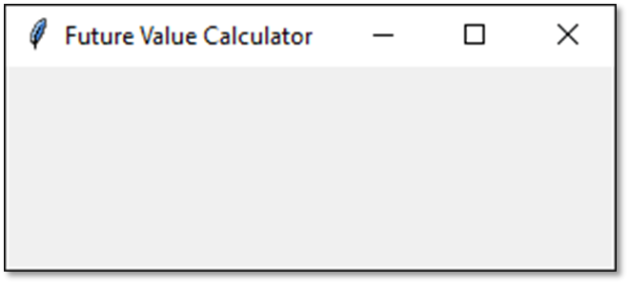
How to import the tkinter module
import tkinter as tk
How to create an empty root window
root = tk.Tk()
root.title("Future Value Calculator")
root.geometry("300x150")
How to make the root window visible
root.mainloop()
An empty root window

Slide 6
Two constructors of the ttk module
Frame(parent[, padding])
Button(parent, text)
A method for working with all components
pack([fill][, expand])

Slide 7
How to import the ttk module
from tkinter import ttk
How to add a frame to the root window
frame = ttk.Frame(root, padding="10 10 10 10")
frame.pack(fill=tk.BOTH, expand=True)

Slide 8
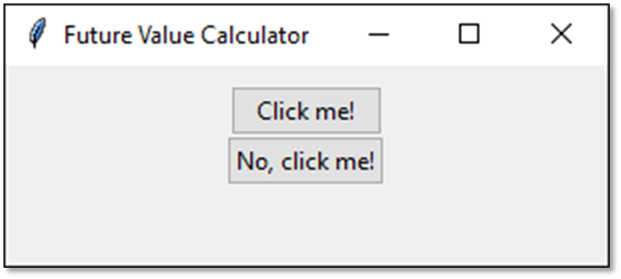
How to add two buttons to the frame
button1 = ttk.Button(frame, text="Click me!")
button2 = ttk.Button(frame, text="No, click me!")
How to display the buttons
button1.pack()
button2.pack()
Two buttons in a frame

Slide 9
An argument of the Button constructor
command
The destroy() method of the root window
destroy()

Slide 10
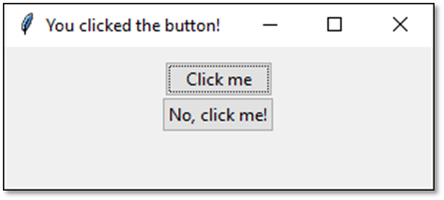
How to connect two buttons to callback functions
button1 = ttk.Button(frame, text="Click me",
command=click_button1)
button2 = ttk.Button(frame, text="No, click me!",
command=click_button2)
The callback functions
def click_button1():
root.title("You clicked the button!")
def click_button2():
root.destroy()
The GUI after the user clicks the first button

Slide 11
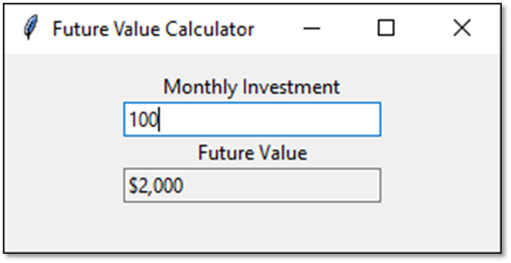
A window with labels and text entry fields

Slide 12
Constructors for labels and text entry fields
Label(parent, text)
Entry(parent, width, textvariable[, state])

Slide 13
How to create a label and display it
investmentLabel = ttk.Label(frame,
text="Monthly Investment")
investmentLabel.pack()
Another way to create a label and display it
ttk.Label(frame, text="Monthly Investment").pack()

Slide 14
Constructors and methods of the StringVar class
StringVar()
get()
set(str)

Slide 15
How to bind a text entry field to a StringVar object
investmentText = tk.StringVar()
investmentEntry = ttk.Entry(frame, width=25,
textvariable=investmentText)
How to create a read-only text entry field
fvText = tk.StringVar()
fvEntry = ttk.Entry(frame, width=25, textvariable=fvText,
state="readonly")
How to get or set a string in a text entry field
investment = investmentText.get()
fvText.set("$2,000")

Slide 16
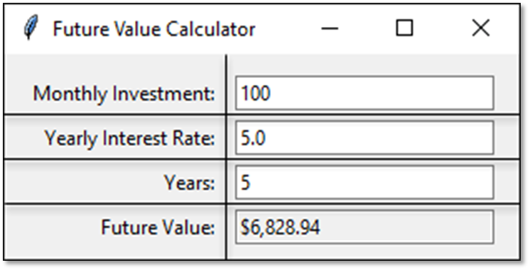
Eight components in a grid

Slide 17
Some arguments of the grid() method
column
row
sticky
padx
pady
columnspan
rowspan

Slide 18
How to lay out components in a grid
ttk.Label(frame, text="Monthly Investment:").grid(
column=0, row=0, sticky=tk.E)
ttk.Entry(frame, width=25,
textvariable=investmentText).grid(
column=1, row=0)
ttk.Label(frame, text="Yearly Interest Rate:").grid(
column=0, row=1, sticky=tk.E)
ttk.Entry(frame, width=25, textvariable=rateText).grid(
column=1, row=1)
How to add padding to all components in a frame
for child in frame.winfo_children(): # get children
child.grid_configure(padx=5, pady=3) # pad each child

Slide 19
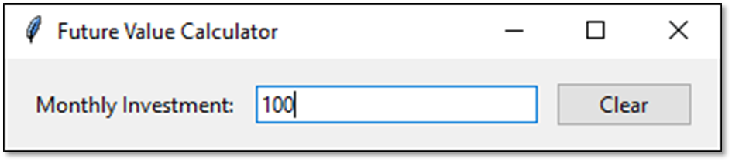
A window that contains a frame

Slide 20
A class that defines a frame (part 1)
import tkinter as tk
from tkinter import ttk
class InvestmentFrame(ttk.Frame):
def __init__(self, parent):
ttk.Frame.__init__(self, parent, padding="10 10 10 10")
self.pack(fill=tk.BOTH, expand=True)
# Define string variable for the entry field
self.monthlyInvestment = tk.StringVar()
# Create a label, an entry field, and a button
ttk.Label(self, text="Monthly Investment:").grid(
column=0, row=0, sticky=tk.E)
ttk.Entry(self, width=25,
textvariable=self.monthlyInvestment).grid(
column=1, row=0)
ttk.Button(self, text="Clear", command=self.clear).grid(
column=2, row=0)

Slide 21
A class that defines a frame (part 2)
# Add padding to all child components
for child in self.winfo_children():
child.grid_configure(padx=5, pady=3)
# Define the callback method for the Clear button
def clear(self):
print("Monthly Investment:",
self.monthlyInvestment.get())
self.monthlyInvestment.set("")
if __name__ == "__main__":
root = tk.Tk() # Create the root window
root.title("Future Value Calculator")
InvestmentFrame(root) # Create the frame
root.mainloop() # Display the frame

Slide 22
Some methods of the messagebox module
showinfo(title, message)
showwarning(title, message)
showerror(title, message)
askyesno(title, message)
askokcancel(title, message)
Two arguments for these methods
title
message

Slide 23
How to display a message box
How to import the messagebox module
from tkinter import messagebox
How to create a message box that displays information
messagebox.showinfo(
"Info", "This application monitors keystrokes.")
How to create a message box that displays an error
messagebox.showerror(
"Error", "Years must be a valid whole number.")
How to create a message box that gets information from a user
response = messagebox.askokcancel(
"Confirm deletion", "Are you sure you want to delete?")
if response == True:
# code that performs deletion

Slide 24
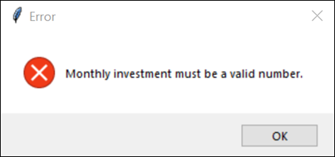
A message box that displays an error message

Slide 25
The GUI for the Future Value Calculator

Slide 26
The business module
from dataclasses import dataclass
@dataclass
class Investment():
monthlyInvestment:float = 0.0
yearlyInterestRate:float = 0.0
years:int = 0
def calculateFutureValue(self):
monthlyInterestRate = self.yearlyInterestRate / 12 / 100
months = self.years * 12
futureValue = 0
for i in range(months):
futureValue += self.monthlyInvestment
monthlyInterestAmount = futureValue *
monthlyInterestRate
futureValue += monthlyInterestAmount
return futureValue

Slide 27
The ui module (part 1)
import tkinter as tk
from tkinter import ttk, messagebox
import locale
from business import Investment
class FutureValueFrame(ttk.Frame):
def __init__(self, parent):
ttk.Frame.__init__(self, parent, padding="10 10 10 10")
self.parent = parent
self.investment = Investment()
self.message = ""
locale.setlocale(locale.LC_ALL, 'en_US')
# Define string variables for text entry fields
self.monthlyInvestment = tk.StringVar()
self.yearlyInterestRate = tk.StringVar()
self.years = tk.StringVar()
self.futureValue = tk.StringVar()
self.initComponents()

Slide 28
The ui module (part 2)
def initComponents(self):
self.pack()
ttk.Label(self, text="Monthly Investment:").grid(
column=0, row=0, sticky=tk.E)
ttk.Entry(self, width=25,
textvariable=self.monthlyInvestment).grid(
column=1, row=0)
ttk.Label(self, text="Yearly Interest Rate:").grid(
column=0, row=1, sticky=tk.E)
ttk.Entry(self, width=25,
textvariable=self.yearlyInterestRate).grid(
column=1, row=1)
ttk.Label(self, text="Years:").grid(
column=0, row=2, sticky=tk.E)
ttk.Entry(self, width=25, textvariable=self.years).grid(
column=1, row=2)

Slide 29
The ui module (part 3)
ttk.Label(self, text="Future Value:").grid(
column=0, row=3, sticky=tk.E)
ttk.Entry(self, width=25, textvariable=self.futureValue,
state="readonly").grid(column=1, row=3)
self.makeButtons()
for child in self.winfo_children():
child.grid_configure(padx=5, pady=3)
def makeButtons(self):
# Create a frame to store the two buttons
buttonFrame = ttk.Frame(self)
buttonFrame.grid(column=0, row=4, columnspan=2, sticky=tk.E)
ttk.Button(buttonFrame, text="Calculate",
command=self.calculate).grid(column=0, row=0,
padx=5)
ttk.Button(buttonFrame, text="Exit",
command=self.parent.destroy).grid(column=1, row=0)

Slide 30
The ui module (part 4)
def get_float(self, val, fieldName):
try:
return float(val)
except ValueError:
self.message += f"{fieldName} must be a valid number.\n"
def get_int(self, val, fieldName):
try:
return int(val)
except ValueError:
self.message += f"{fieldName} must be a valid whole"
f"number.\n"

Slide 31
The ui module (part 5)
def calculate(self):
self.message = ""
self.investment.monthlyInvestment = self.get_float(
self.monthlyInvestment.get(), "Monthly investment")
self.investment.yearlyInterestRate = self.get_float(
self.yearlyInterestRate.get(), "Yearly interest rate")
self.investment.years = self.get_int(
self.years.get(), "Years")
if self.message == "": # no errors
self.futureValue.set(locale.currency(
self.investment.calculateFutureValue(),
grouping=True))
else:
messagebox.showerror("Error", self.message)
if __name__ == "__main__":
root = tk.Tk()
root.title("Future Value Calculator")
FutureValueFrame(root)
root.mainloop()

